Slide 1
Midnnight Science GUI

Slide 2
GUI Graphical Structure
Main
Filebar
AuxBar
PathSelector
HorizTabCollection
Plotter
Add Subplot
PlotManager
GraphFrameContainer
ResFileManager(TogglePaneDel)
+
Add Res File Pane
ResFilePane
FileSelectorDel
Sig 1
Sig 2
ResFilePane
FileSelectorDel
Sig 1
Sig 2
ResFileManager(TogglePaneDel)
+
Add Res File Pane
ResFilePane
FileSelectorDel
Sig 1
Sig 2
VerticalScrollText

Slide 3
Model Structure
class PlotModel
Title = str
plotNo = int
noOfSubplots = int
containedSubplot = [SubplotModel]
class SubplotModel
title=str
subplotNo=int
xLabel=str
yLabel=str
xTick=doube
yTick=double
grid=double
xAxis=[double]
resultFiles=[ResultFile]
plottedSignal=PlottedSignal
class ResultFile
name=str
resultNo=int
absPath=str
signals={Signal}
class PlottedSignals
signals={signalsCurves}
class Signal
name=str
unit=str
data=[double]
class SignalCurve(&Signal)
color=[double]
thickness=double
marker=str
linestyle=str

Slide 4
General Event Sequence
Click a button
Update the model
Update the model
Redraw plot manager pane
Redraw plot ui

Slide 5
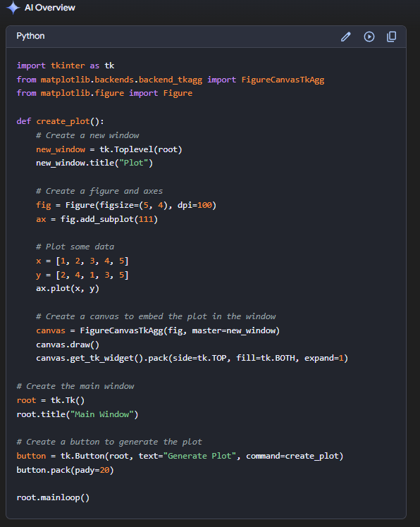
How to create plot in a new window

Slide 6
Icons
DARK

Slide 7
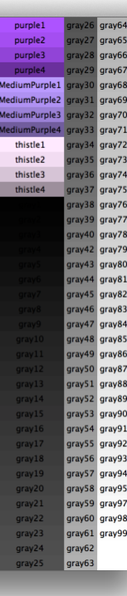
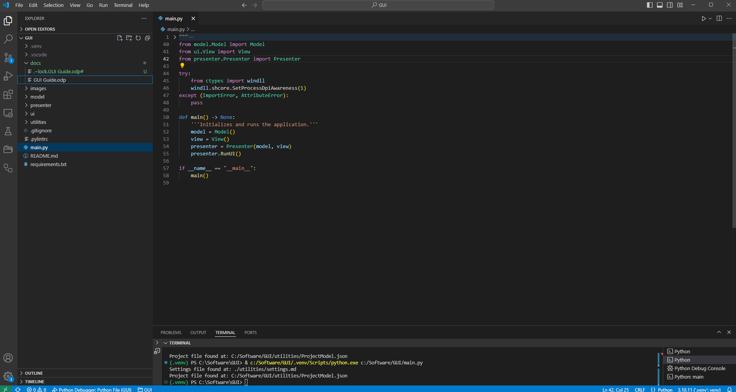
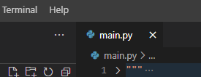
Color Scheme
Gray18 3c3c3c
Gray11
Gray11
Gray11
Gray9
Gray15
464646
3c3c3c
323232
252525
Gray90
Gray90
1e1e1e
Gray100

Slide 8
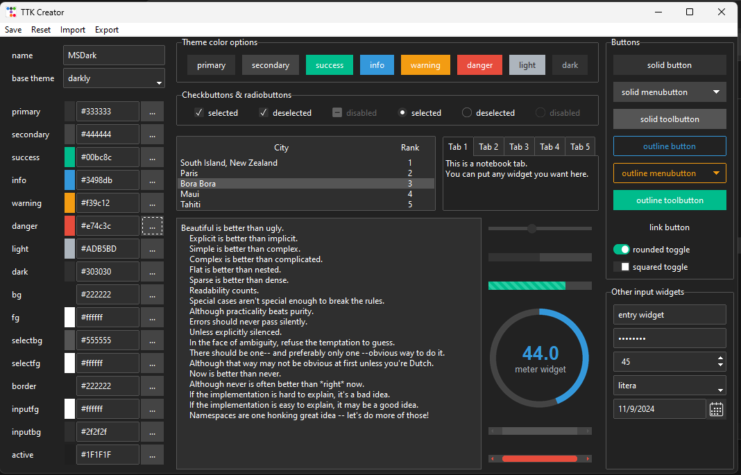
Frame bg
Label and tabs
Border of the selected items
Foreground of the selected items
Useless
Input foreground

